Slide 1
Unit -II

Slide 2
CLIENT SIDE AND SERVER SIDE PROGRAMMING Java Script
An introduction to JavaScript–Control statement-Functions-Array-Objects. Servlets: Java Servlet Architecture- Servlet Life Cycle- Handling the client request form data- Session Tracking- Handling Cookies- Installing and Configuring Apache Tomcat Web Server; DATABASE CONNECTIVITY: JDBC perspectives, JDBC program example - JSP: Understanding Java Server Pages-JSP Standard Tag Library(JSTL)-Creating HTML forms by embedding JSP code.

Slide 3
An introduction to JavaScript
JavaScript was created by Brendan Eich and it came into existence in September 1995, when Netscape 2.0 (a web browser) was released
JavaScript was designed with a purpose to make web pages dynamic and more interactive.
JavaScript is one of the popular scripting languages having following features :
(a) It can be used for client and server applications.
(b) It is platform independent which means it can run on any operating systems (i.e. Linux, Microsoft Windows, Mac OS X etc.).
(c) JavaScript codes are needed to be embedded or referenced into HTML documents then only it can run on a web browser.
(d) It is an interpreted language.
(e) It is a case-sensitive language and its keywords are in lowercase only.

Slide 4
An introduction to JavaScript
DIFFERENCE BETWEEN JAVA AND JAVASCRIPT
Java is a general-purpose object oriented programming language from Sun Microsystems where as JavaScript is an object-based scripting language.
Script refers to short programming statements to perform a task

Slide 5
An introduction to JavaScript
CLIENT SERVER MODEL
CLIENT
It is a node computer that establishes connection with the server, collects data from the user, sends it to the server, receives information from the server and presents it to the user.
SERVER
In the context of client-server model, server is the counter part of client. It is a computer that serves queries from the client. The programs which respond to the request of clients are known as server applications. The computer designed to run server application is known as server machine. Web server, database server and mail server are some examples of servers

Slide 6
An introduction to JavaScript
GETTING STARTED WITH JAVASCRIPT
JavaScript is not a full-fledged language and it needs to be embedded within a HTML document.
Otherwise, or to specify an external file that contains the JavaScript code we can use word script or program for the JavaScript code.
The most common way to set off a script is to use the HTML <script> and </script> tags in HTML document.
We can place our JavaScript code in either the HEAD or BODY section of a HTML document

Slide 7
An introduction to JavaScript

Slide 8
An introduction to JavaScript

Slide 9
Java Script Control Statements

Slide 10
Java Script Arrays

Slide 11
Java Script Arrays

Slide 12
Java Script Arrays

Slide 13
Java Script Functions

Slide 14
Java Script Functions

Slide 15
Java Script Functions

Slide 16
Questions
Write Java Script Program to change background and text colors dynamically
Write Java Script Program to change font dynamically using Mouse over Events

Slide 17
Java script Objects

Slide 18
Java script Objects

Slide 19
Java script Objects

Slide 20
Java Servlets
Java Servlets are programs that run on a Web or Application server and act as a middle layer between a requests coming from a Web browser or other HTTP client and databases or applications on the HTTP server.
Using Servlets, you can collect input from users through web page forms, present records from a database or another source, and create web pages dynamically.
Java Servlets often serve the same purpose as programs implemented using the Common Gateway Interface (CGI). But Servlets offer several advantages in comparison with the CGI.

Slide 21
Java Servlets
Performance is significantly better.
Servlets execute within the address space of a Web server. It is not necessary to create a separate process to handle each client request.
Servlets are platform -independent because they are written in Java.
Java security manager on the server enforces a set of restrictions to protect the resources on a server machine. So servlets are trusted.
The full functionality of the Java class libraries is available to a servlet.
It can communicate with applets, databases, or other software via the sockets and RMI mechanisms that you have seen already.

Slide 22
Servlet Architecture

Slide 23
Servlets Tasks
Read the explicit data sent by the clients (browsers). This includes an HTML form on a Web page or it could also come from an applet or a custom HTTP client program.
Read the implicit HTTP request data sent by the clients (browsers). This includes cookies, media types and compression schemes the browser understands, and so forth.
Process the data and generate the results. This process may require talking to a database, executing an RMI or CORBA call, invoking a Web service, or computing the response directly.
Send the explicit data (i.e., the document) to the clients (browsers). This document can be sent in a variety of formats, including text (HTML or XML), binary (GIF images), Excel, etc.
Send the implicit HTTP response to the clients (browsers). This includes telling the browsers or other clients what type of document is being returned (e.g., HTML), setting cookies and caching parameters, and other such tasks.

Slide 24
Servlet Packages
Java Servlets are Java classes run by a web server that has an interpreter that supports the Java Servlet specification.
Servlets can be created using the javax.servlet and javax.servlet.http packages, which are a standard part of the Java's enterprise edition, an expanded version of the Java class library that supports large-scale development projects.
These classes implement the Java Servlet and JSP specifications. At the time of writing this tutorial, the versions are Java Servlet 2.5 and JSP 2.1 .
Java servlets have been created and compiled just like any other Java class. After you install the servlet packages and add them to your computer's Class path, you can compile servlets with the JDK's Java compiler or any other current compiler.

Slide 25
Servlet Life Cycle
A servlet life cycle can be defined as the entire process from its creation till the destruction. The following are the paths followed by a servlet
The servlet is initialized by calling the init () method.
The servlet calls service() method to process a client's request.
The servlet is terminated by calling the destroy() method.
Finally, servlet is garbage collected by the garbage collector of the JVM.

Slide 26
Servlet Life Cycle
The init() method :
The init method is designed to be called only once. It is called when the servlet is first created, and not called again for each user request. So, it is used for one-time initializations, just as with the init method of applets.
The init method definition looks like this:
public void init() throws ServletException { // Initialization code... }

Slide 27
The service method
The service method is the main method to perform the actual task. The servlet container i.e.webserver calls the service method to handle requests coming from the clientbrowsers and to write the formatted response back to the client.
Each time the server receives a request for a servlet, the server spawns a new thread and calls service.
The service method checks the HTTP request type GET,POST,PUT,DELETE,etc. and calls doGet, doPost, doPut, doDelete, etc. methods as appropriate.
Here is the signature of this method:
public void service(ServletRequest request, ServletResponse response) throws ServletException, IOException{ }
The service method is called by the container and service method invokes doGe, doPost, doPut, doDelete, etc. methods as appropriate.

Slide 28
Do Get and Do Post Method
The doGet Method A GET request results from a normal request for a URL or from an HTML form that has no METHOD specified and it should be handled by doGet method.
public void doGet(HttpServletRequest request, HttpServletResponse response) throws ServletException, IOException { // Servlet code } The doPost Method A POST request results from an HTML form that specifically lists POST as the METHOD and it should be handled by doPost method.
public void doPost(HttpServletRequest request, HttpServletResponse response) throws ServletException, IOException { // Servlet code }

Slide 29
Destroy Method
The destroy method : The destroy method is called only once at the end of the life cycle of a servlet. This method gives your servlet a chance to close database connections, halt background threads, write cookie lists or hit counts to disk, and perform other such cleanup activities. After the destroy method is called, the servlet object is marked for garbage collection. The destroy method definition looks like this:
public void destroy() { // Finalization code...

Slide 30
Architecture Diagram
The following figure depicts a typical servlet life-cycle scenario.
First the HTTP requests coming to the server are delegated to the servlet container.
The servlet container loads the servlet before invoking the service method.
Then the servlet container handles multiple requests by spawning multiple threads, each thread executing the service method of a single instance of the servlet.

Slide 31
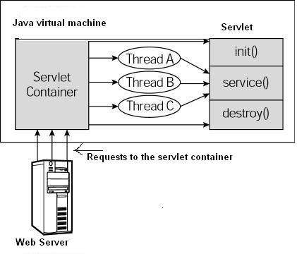
Architecture Diagram

Slide 32
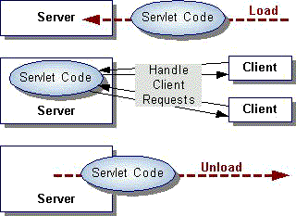
The Servlet Life Cycle

Slide 33
Handling the Client Request: Form Data
Example URL at online travel agent
http://host/path?user=Marty+Hall&origin=iad&dest=nrt
Names (user) come from HTML author; values (Marty+Hall) usually come from end user
Parsing form (query) data in traditional CGI
Read the data one way for GET requests, another way for POST requests
Chop pairs at &, then separate parameter names (left of the "=") from parameter values (right of the "=")
URL decode values (e.g., "%7E" becomes "~")
Need special cases for omitted values (param1=val1&param2=&param3=val3) and repeated params (param1=val1&param2=val2&param1=val3)
Notes:
ServletTM programmers almost never have to worry about these funny cases.

Slide 34
Reading Form Data (Query Data)
getParameter("name")
Returns value as user entered it. I.e., URL-decoded value of first occurrence of name in query string.
Works identically for GET and POST requests
Returns null if no such parameter is in query
getParameterValues("name")
Returns an array of the URL-decoded values of all occurrences of name in query string
Returns a one-element array if param not repeated
Returns null if no such parameter is in query
getParameterNames()
Returns Enumeration of request params
Notes:
A simple call to getParameter assumes a single character set. You have to do more work if input might be in multiple character sets.
Here is an example that allows either Latin or Japanese input: String val = response.getParameter(“paramName”); if (val != null) { val = new String(val.getBytes(“8859_1”), “JISAutodetect”); }

Slide 35
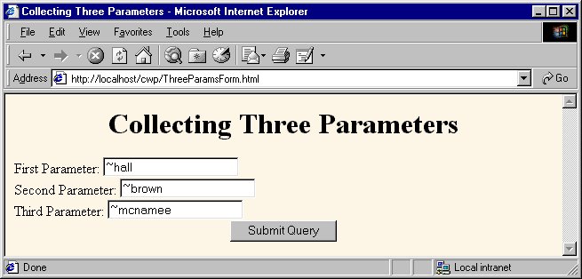
An HTML Form With Three Parameters
<FORM ACTION="/servlet/cwp.ThreeParams">
First Parameter: <INPUT TYPE="TEXT" NAME="param1"><BR>
Second Parameter: <INPUT TYPE="TEXT" NAME="param2"><BR>
Third Parameter: <INPUT TYPE="TEXT" NAME="param3"><BR>
<CENTER><INPUT TYPE="SUBMIT"></CENTER>
</FORM>

Slide 36
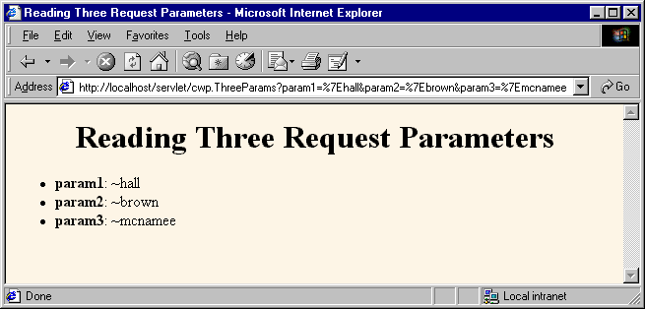
Reading the Three Parameters
public class ThreeParams extends HttpServlet {
public void doGet(HttpServletRequest request, HttpServletResponse response)
throws ServletException, IOException {
response.setContentType("text/html");
PrintWriter out = response.getWriter();
String title = "Reading Three Request Parameters";
out.println(ServletUtilities.headWithTitle(title) +
"<BODY BGCOLOR=\"#FDF5E6\">\n" +"<H1 ALIGN=CENTER>" + title + "</H1>\n" + "<UL>\n" +
" <LI><B>param1</B>: " + request.getParameter("param1") + "\n" +
" <LI><B>param2</B>: " + request.getParameter("param2") + "\n" +
" <LI><B>param3</B>: " + request.getParameter("param3") + "\n" +
"</UL>\n" + "</BODY></HTML>"); }}

Slide 37
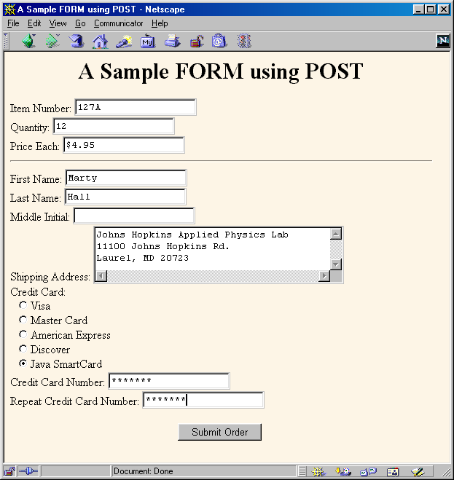
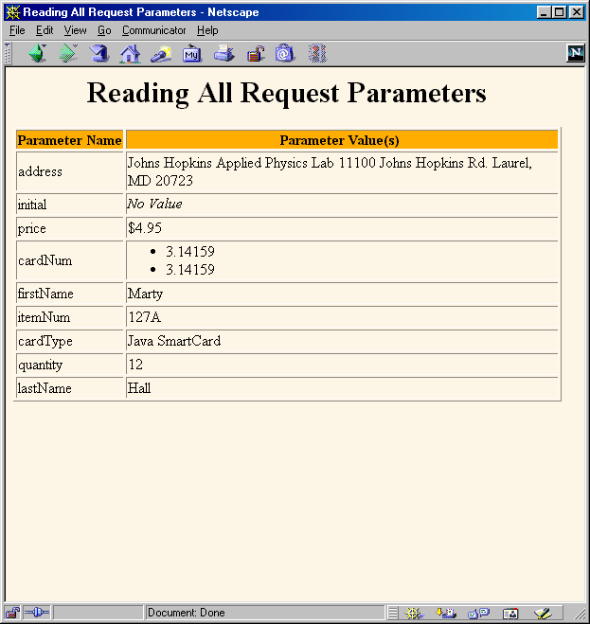
Result of ShowParameters Servlet Server receives the data from user
Note that order of parameters in Enumeration does not match order they appeared in Web page

Slide 38
Session Tracking with Servlets
HTTP is a stateless protocol.
We must have each user introduce themselves in some way.
We’ll look at traditional session tracking and then look at the
Session Tracking API.

Slide 39
Traditional Session Tracking
User Authorization
Hidden Form fields
URL Rewriting
Persistent cookies
We’ll look at the first and last.

Slide 40
User Authorization
The web server requests the user name and password.
The information is available to any servlet that needs it.
The browser resends the name and password with each
subsequent request.
Data about the user and the user’s state can be saved in a shared
object.

Slide 41
Shared Objects
A convenient way to store data associated with a user.
There are likely to be many servlets running.
They can collaborate through a shared object.
Only one instance of the shared object should exist.
It has to be available (in the classpath) of the servlets
that needs it.
It will be used by several threads and therefore should
protect itself against simultaneous access.
We’ll look at a shared object and two servlets that use it.

Slide 42
VisitTracker.java
// Servlet collaboration can be done through a shared object.
// Any servlet has access to this object and it only has one
// instance.
// It maintains a hash table of names and dates.
// Sections of code that must not be executed simultaneously
// are called critical sections. Java provides the synchronized
// keyword to protect these critical sections. For a synchronized
// instance method, Java obtains an exclusive lock on the class
// instance.
import java.util.*;

Slide 43
public class VisitTracker {
private Map nameDatePairs;
private static VisitTracker instance = new VisitTracker();
private VisitTracker() { // private constructor
nameDatePairs = new HashMap();
}
public static VisitTracker getInstance() { return instance; }
synchronized public void addVisit(String userName) {
nameDatePairs.put(userName, new Date());
}

Slide 44
synchronized public Date lastVisit(String name) {
Date d = (Date)nameDatePairs.get(name);
return d;
}
}

Slide 45
User Authorization
Administered by the web server – Jigsaw
In Jigsaw, add a GenericAuthFilter to a ServletWrapperFrame.
From within the servlet use String name = req.getRemoteUser();
to access the user name.
The following will keep track of the date of the last visit.

Slide 46
// UserAuthorizationDemo.java
// This servlet reads from Jigsaw and finds the name of the
// authorized user. It then adds it to a hash table storing
// the time of this visit. It makes use of VisitTracker.
import java.io.*;
import java.util.*;
import javax.servlet.*;
import javax.servlet.http.*;
public class UserAuthorizationDemo extends HttpServlet {
public void doGet(HttpServletRequest req, HttpServletResponse res)
throws ServletException, IOException {

Slide 47
res.setContentType("text/plain");
PrintWriter out = res.getWriter();
String name = req.getRemoteUser();
if(name == null) {
System.out.println("The system administrator should protect" +
" this page.");
}
else {
out.println("This user was authorized by the server:" + name);
VisitTracker visit = VisitTracker.getInstance();
Date last = visit.lastVisit(name);
if(last == null) out.println("Welcome, you were never here before");
else out.println("Your last visit was on " + last);
visit.addVisit(name);
}
}
}

Slide 48
Cookies
A cookie is a bit of information sent by a web server
to a browser that can later be read back from that browser.
The server can take that bit of information and use it as a
key to recover information about prior visits. This
information may be in a database or a shared object.
Cookies are read from the request object by calling
getCookies() on the request object.
Cookies are placed in the browser by calling addCookie()
on the response object.

Slide 49
Using Cookies
// CookieDemo.java
// This servlet uses a cookie to determine when the
// last visit by this browser occurred. It makes use of
// the VisitTracker object.
// Cookies normally expire as soon as the browser exits.
// We want the cookie to last one year and so we use
// setMaxAge(seconds) on the cookie.
import java.io.*;
import java.util.*;
import javax.servlet.*;
import javax.servlet.http.*;

Slide 50
public class CookieDemo extends HttpServlet {
public void doGet(HttpServletRequest req, HttpServletResponse res)
throws ServletException, IOException {
res.setContentType("text/plain");
PrintWriter out = res.getWriter();
Cookie[] c = req.getCookies();
// If this person has been here before then we should have
// a cookiedemouser field assigned to a unique id.
String id = null;

Slide 51
if (c!=null) { // we may have the cookie we are after
for (int i=0;i<c.length;i++) {
if (c[i].getName().equals("cookiedemouser")) {
id = c[i].getValue();
}
break;
}
}

Slide 52
if (id == null) {
// They have not been here before and need a
// cookie. We get a unique string and make sure
// it is of the 'query string' form.
String uid = new java.rmi.server.UID().toString();
id = java.net.URLEncoder.encode(uid);
Cookie oreo = new Cookie("cookiedemouser",id);
oreo.setMaxAge(60*60*24*365);
res.addCookie(oreo);
}
VisitTracker visit = VisitTracker.getInstance();
Date last = visit.lastVisit(id);
if(last == null) out.println("Welcome, you were never here before");
else out.println("Your last visit was on " + last);
visit.addVisit(id);
}
}

Slide 53
The New Session Tracking API
Support may vary depending on the server.
Implemented with cookies or with URL rewriting if cookies
fail (URL rewriting requires help from the servlet).
Every user of the site is associated with a
javax.servlet.http.HttpSession object
The session object can hold any arbitrary set of Java objects.
Servlets collaborate by accessing the session object.
The following example abstracts away shared object concerns.
All valid sessions are grouped together in a HttpSessionContext
object

Slide 54
The Session Tracking API
// SessionDemo.java
// The session object associated with this user/browser is available
// to other servlets.
import java.io.*;
import javax.servlet.*;
import javax.servlet.http.*;
import java.util.*;
public class SessionDemo extends HttpServlet {

Slide 55
public void doGet(HttpServletRequest req, HttpServletResponse res)
throws ServletException, IOException {
res.setContentType("text/plain");
PrintWriter out = res.getWriter();
// Get the current session object. Create one if none exists.
HttpSession session = req.getSession(true);
// Get the Date associated with this session
Date d = (Date)session.getAttribute("dateofvisit");
if(d == null) out.println("Your first time, welcome!");
else out.println("Your last visit was on " + d);
session.setAttribute("dateofvisit", new Date());
} }

Slide 56
Servlets and JDBC
A simple servlet that:
-- requests that the user login
-- checks the id and password against an access database
-- allows the user to withdraw or deposit money in their
account
-- cookies are used for session tracking
-- Gary Alperson provided the program and the slides

Slide 57
BankServlet Architecture
doPost()
This method is called for all server requests. It uses cookies to determine the state of the session and calls the appropriate methods accordingly
GenerateHTML.java
This class has methods to generate HTML text. Subclasses return HTML for particular pages

Slide 58
GenerateHTML.java
getHeader() generates an HTML header, getting the page title from getTitle()
public class GenerateHTML{
public String getHeader(String s) {
return "<html><Header><title>"+ getTitle(s)+"</title></header>";
}
public String getTitle(String s) {
return "Page Title";
}
public String getBody(String s) {
return "<body>"+ getBodyText(s) + "</body></html>";
}
public String getBodyText(String s) {
return "Page Body";
}
}
getTitle() should be overridden in subclasses to generate a page title specific to each page
getBody() generates the body of the HTML page, enclosing page-specific contents from getBodyText()
getBodyText() should be overridden in subclasses to generate content specific to each page

Slide 59
BankServlet.java
import java.util.*;
import java.util.Enumeration;
import java.io.*;
import javax.servlet.*;
import javax.servlet.http.*;
import java.sql.*;
public class BankServlet extends HttpServlet implements SingleThreadModel {
private Connection con;
SingleThreadModel will be explained later

Slide 60
init()
Both doGet() and doPost are called by service(). These methods
handle the particular type of HTTP request.
The init() method is called when the servlet is first created and is
not called again for each user request. Be sure to call the base class init() with super.init(config);
public void init(ServletConfig config) throws ServletException {
super.init(config);
try {
DriverManager.registerDriver(new sun.jdbc.odbc.JdbcOdbcDriver());
con = DriverManager.getConnection("jdbc:odbc:bank");
}
catch(SQLException e) {
System.out.println("SQL Exception: "+e);
}
}

Slide 61
doPost()
Cookie code deleted for now. We will look at it later.
public void doPost(HttpServletRequest req, HttpServletResponse res)
throws IOException {
String user ="";
res.setContentType("text/html");
ServletOutputStream out;
out = res.getOutputStream();
//Code related to cookie deleted. We will look at it later.
boolean sessionExists = false;
//More cookie code deleted
if (sessionExists) {
//More cookie code deleted
out.println(doLogin(res));
out.close();
}
Response object set for HTML
The result of doLogin is added to the output stream. Note that the response object is passed to doLogin()
The output stream is closed

Slide 62
doLogin()
public String doLogin(HttpServletResponse res) {
Cookie c = new Cookie("exists","true");
res.addCookie(c);
GenerateLogin gen = new GenerateLogin();
return(gen.getHeader("")+gen.getBody(""));
}
A cookie named “Exists” is created containing the value “True”
The cookie is added to the response object
The results of using a GenerateLogin object are returned to doPost() to be printed

Slide 63
GenerateLogin
public class GenerateLogin extends GenerateHTML {
public String getTitle(String s) {
return "Login Screen";
}
public String getBodyText(String s) {
//This form contains 2 text boxes, for the username and password.
return "<form ACTION=\"/servlet/BankServlet\" METHOD=\"POST\">"+
"User Name: <input type=\"text\" name=\"name\"><br>" +
"Password: <input type=\"text\" name=\"password\"><p>" +
"<INPUT TYPE=SUBMIT Value=\'Login\'></Form>";
}
}
Overrides getTitle() to name the page “Login Screen”
Overrides getBodyText() to make Form that calls doPost() on the same servlet (BankServlet)

Slide 64
Login Screen
Overrides getTitle() to name the page “Login Screen”

Slide 65
doPost() is Called Again
public void doPost(HttpServletRequest req, HttpServletResponse res) throws IOException {
//Code relating to response object was already reviewed
Cookie[] c = req.getCookies();
boolean sessionExists = false;
boolean loggedIn = false;
if (c==null)
out.println(doLogin(res));
else {
for (int i=0;i<c.length;i++) {
if (c[i].getName().equals("exists"))
sessionExists = true;
if (c[i].getName().equals("user")) {
loggedIn = true;
user = c[i].getValue();
}
}
An array of cookies is instantiated to hold the cookies from the request object
If the array is null, there are no cookies, so the Login Screen is generated
Otherwise, each cookie is checked. The getName() method gets the name of the cookie attribute. The Login screen added the “exists” cookie, so sessionExists will be set to true. We have not yet seen the “user” cookie, so loggedIn will remain false.
The getValue() method gets the data that has been added to that cookie.

Slide 66
if (sessionExists) {
if (loggedIn)
out.println(processTrans(req, res, user));
else
out.println(giveOptions(req, res));
}
else
out.println(doLogin(res));
out.close();
}
}
sessionExists is true. loggedIn is false. The response object therefore prints the results of giveOptions()
Both the request and response object are passed

Slide 67
giveOptions()
public String giveOptions
(HttpServletRequest req, HttpServletResponse res) {
String user = req.getParameter("name");
String password = req.getParameter("password");
The username and password are retrieved from the request object passed by the Form

Slide 68
try {
Statement s = con.createStatement();
ResultSet r;
r = s.executeQuery("SELECT * FROM customer WHERE username =\'" +
user+"\' AND password = \'" + password +"\';");
Select a record with a matching username and password from the database
SELECT *
FROM customer
WHERE username = user
AND password = password;

Slide 69
The ResultSet’s next() method will only be true if the select statement returned data (ie the user and password are valid)
if (r.next()) {
GenerateOptions gen = new GenerateOptions();
String code = gen.getHeader(user);
code +=(gen.getBody(r.getString("balance")));
Cookie c = new Cookie("user",user);
res.addCookie(c);
return code;
}
//Code if r.next is false will be reviewed later
The results of using a GenerateOptions object are placed in a String. The username is passed to getHeader()
The data in the balance attribute is taken from the ResultSet and passed to getBody()
A cookie named “User” is created containing the username and added to the response object

Slide 70
GenerateOptions
public class GenerateOptions extends GenerateHTML {
public String getTitle(String s) {
return "Welcome "+s;
}
public String getBodyText(String s) {
String text;
text ="<form action=\"BankServlet\" method=\“POST\">"+
"<table><tr><td colspan =2><H2 align=center>"+
"Choose an Option</h2></td></tr>";
Overrides getTitle() to name the page Welcome followed by the username
Overrides getBodyText() to make Form that calls doPost() on the same servlet (BankServlet)

Slide 71
text+="<tr><td><input type=radio name=act value=deposit checked></td>"+
"<td>Deposit</td></tr>"+
"<tr><td><input type=radio name=act value=withdraw></td>"+
"<td>Withdraw</td></tr>";
text+="<tr><td >Enter Amount:</td>"+
"<td>$<input type=text name=amount></td></tr>"+
"<tr><td colspan=2><input type=submit value=Submit></td>"+
"<td><input type=reset value=Reset></td></tr>"+
"<tr><td colspan=2><h3 align=center>Your current balance is: $"+
s+"</td></tr></table>";
return text;
}
}
The checked attribute on a radio button checks it by default so that the user cannot leave it blank
A reset input type clears the form

Slide 72
Options Screen

Slide 73
giveOptions() Revisited
We looked at the code from if the username and password were valid
try{
if (r.next)
//Previously reviewed code
else {
return(getRejection("missing"));
}
}
catch(SQLException e) {
return(getRejection("db"));
}
If no match was found in the database or if there is an SQLException, we pass a particular String to getRejection() and return the result to doPost()

Slide 74
getRejection()
public String getRejection(String s) {
GenerateReject gen = new GenerateReject();
String problem ="Error";
if (s.equals("missing"))
problem = "You did not enter a valid user name and password.";
if (s.equals("db"))
problem = "Database Error";
if (s.equals("overdraw"))
problem="You may not withdraw more than your balance.";
if (s.equals("invalid"))
problem="You must fill out the form correctly.";
return gen.getHeader(problem)+ gen.getBody(problem);
}
Missing or invalid username and password
SQLException
The results of using a GenerateReject object are returned

Slide 75
GenerateReject
public class GenerateReject extends GenerateHTML{
public String getTitle(String s) {
return ("Error");
}
public String getBodyText(String s) {
return "<h2 align=center>Error: "+s+"</h2>";
}
}
Overrides getTitle() to name the page Error
Overrides getBodyText() to print the String that was passed to it

Slide 76
Error Screen

Slide 77
3rd Visit to doPost()
sessionExists and loggedIn are both true. The response object therefore prints the results of processTrans()
if (sessionExists) {
if (loggedIn)
out.println(processTrans(req, res, user));
else
out.println(giveOptions(req, res));
}
else
out.println(doLogin(res));
out.close();
}
}
The request and response object and the username are passed

Slide 78
processTrans()
public String processTrans
(HttpServletRequest req, HttpServletResponse res, String user) {
boolean isDouble = true;
double amount=0;
try {
Double d = new Double(req.getParameter("amount"));
amount = d.doubleValue();
}
catch (Exception e) {
isDouble = false;
}
Since the form text fields are Strings, “amount” needs to be wrapped in a Double object before it may be placed in a double variable
If the amount is non-numeric or blank, an exception will be thrown. The catch clause sets the boolean isDouble to false

Slide 79
if (isDouble) {
try {
Statement s = con.createStatement();
String s1="UPDATE customer SET balance =(";
String s2=") WHERE username =\'"+user+"\';";
ResultSet r;
r = s.executeQuery("SELECT balance FROM customer WHERE "+
"username =\'" + user+"\';");
r.next();
double currentBalance = r.getDouble("balance");
String action = req.getParameter("act");
If the amount can convert to a double, the servlet begins preparing an SQL statement. (Most is the same for deposits or withdrawals.)
The current bank balance is retrieved from the database
The radio button contents are retrieved from the request object

Slide 80
If the withdraw radio button was selected, the servlet checks to prevent overdrawing the account. If there is an overdraw, the results of the error method, getRejection() are returned to doPost()
if (action.equals("withdraw")) {
if (amount > currentBalance)
return(getRejection("overdraw"));
else {
amount = currentBalance-amount;
int success = s.executeUpdate(s1+amount+s2);
return(getUpdate(success,amount));
}
}
If the current balance is high enough, the servlet combines the two parts of the query String, surrounding the new balance and returns the results of the getUpdate() method
else {
amount +=currentBalance;
int success = s.executeUpdate(s1+amount+s2);
return(getUpdate(success,amount));
}
//Rest of method will be
//examined later
A deposit works the same way, except that it does not worry about overdrafts
executeUpdate() returns the number of rows changed or 0 if no update was made. This and the updated balance get passed to getUpdate()

Slide 81
Database Integrity Question
The current balance was selected, additional code was run, and then the balance was updated.
How do we prevent the servlet from running another request to change the balance between the select and update statement?
BankServlet implements SingleThreadModel to limit the servlet to one thread at a time. No other user can access the database until the current request has been processed

Slide 82
getUpdate()
public String getUpdate(int success, double amount) {
if (success ==0)
return(getRejection("db"));
.
GenerateResult gen = new GenerateResult();
Double d = new Double(amount);
String s = d.toString();
return gen.getHeader(s)+gen.getBody(s);
}
}
If no rows were updated we pass a particular String to getRejection() and return the result to doPost()
Otherwise we create a new GenerateResult object, pass the new balance to it as a String, and return the result to doPost()

Slide 83
GenerateResult
public class GenerateResult extends GenerateHTML{
public String getTitle(String s) {
return ("Transaction Successful");
}
public String getBodyText(String s) {
return "<h2 align=center>Transaction Successful</h2>"+
"<h3>Your new balance is $"+s+"</h3>";
}
}
getTitle() is overrridden to name the page Transaction Successful
getBodyText() is overridden to provide HTML including the new balance, which is passed to it.

Slide 84
Transaction Successful

Slide 85
processTrans() Revisited
/*Deposits and withdrawals were completed within an if statement,
*if the boolean isAmount was true, followed by a try block
*surrounding the SQL statement
*/
catch (SQLException e) {
return(getRejection("db"));
}
}
else {
return(getRejection("invalid"));
}
}
If there is an SQLException, we pass a particular String to getRejection() and return the result to doPost()
If isDouble is false, we pass a particular String to getRejection() and return the result to doPost()

Slide 86
getReject() Revisited
public String getRejection(String s) {
GenerateReject gen = new GenerateReject();
String problem ="Error";
if (s.equals("missing"))
problem = "You did not enter a valid user name and password.";
if (s.equals("db"))
problem = "Database Error";
if (s.equals("overdraw"))
problem="You may not withdraw more than your balance.";
if (s.equals("invalid"))
problem="You must fill out the form correctly.";
return gen.getHeader(problem)+ gen.getBody(problem);
}
Invalid username or password
Database error / SQLException
If withdrawal exceeds balance
Blank or non-numeric amount entered on form

Slide 87
What is Tomcat?
Tomcat is a Servlet container (Web server that interacts with Servlets) developed under the Jakarta Project of Apache Software Foundation
Tomcat implements the Servlet and the Java Server Pages (JSP) specifications of Sun Microsystems
Tomcat is an open-source, non commercial project
Licensed under the Apache Software License
Tomcat is written in Java (OS independent)

Slide 88
Running Tomcat

Slide 89
Tomcat Directory Structure

Slide 90
Base and Home Directories
The directory TOMCAT-HOME contains executables and libraries required for the server launching, running and stopping
This directory is placed under /usr/local/…
The directory TOMCAT-BASE contains the Web-site content, Web applications and configuration data
This directory is placed under your home directory

Slide 91
Installing Tomcat
Create a directory for tomcat base
For example: mkdir ~/tomcat-base
Set the environment variable CATALINA_BASE to your tomcat-base directory
For example: setenv CATALINA_BASE ~/tomcat-base
Insert this line into your .cshrc file
Run ~dbi/tomcat/bin/setup
$CATALINA_BASE is now a regular Tomcat base directory, and Tomcat is ready to run

Slide 92
Running Tomcat
To start tomcat use ~dbi/tomcat/bin/catalina run
Or, in background, ~dbi/tomcat/bin/catalina start
To stop tomcat use ~dbi/tomcat/bin/catalina stop
To see the default page of Tomcat from your browser use the URL http://<machine-name>:<port>/
machine-name is the name of the machine on which Tomcat runs and port is the port you chose for Tomcat
You can also use http://localhost:<port>/ if your browser runs on the same machine as Tomcat

Slide 93
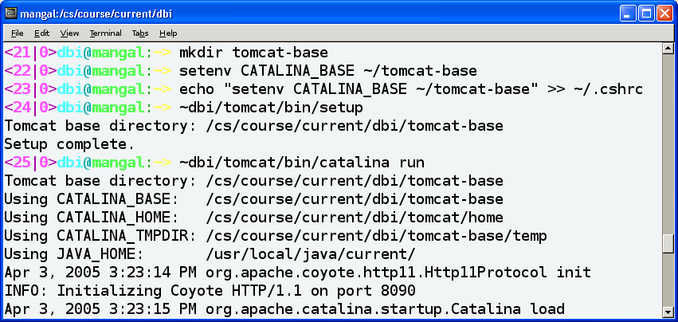
From Scratch to Server

Slide 94
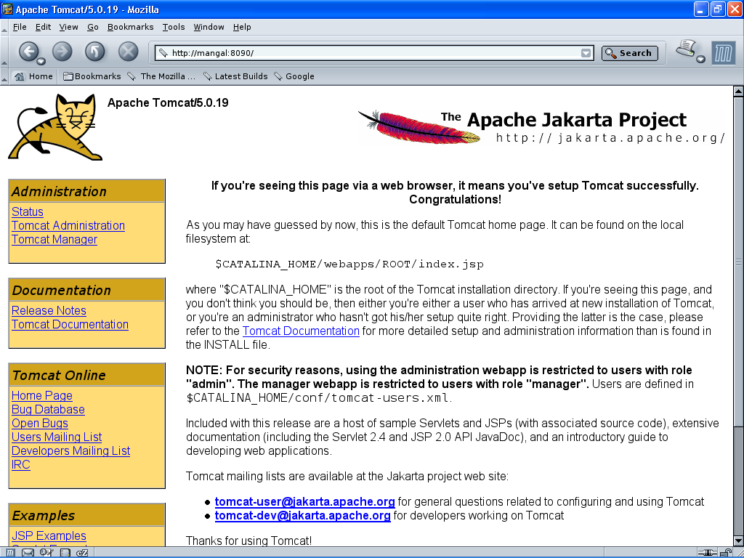

Slide 95
Choosing a port for Tomcat
In the file $CATALINA_HOME/conf/server.xml you will find the element Connector of Service “Catalina”
Choose a port (greater than 1024) and change the value of the port attribute to your chosen one:
<Server>
…
<Service name="Catalina”>
<Connector port="8090"/>
…
</Service>
…
</Server>

Slide 96
Creating Web Applications

Slide 97
Creating Web Applications
A Web application is a self-contained subtree of the Web site
A Web application usually contains several Web resources like HTML files, Servlets, JSP files, and other resources like Database tables
Each Web application has its own subdirectory under the directory
$CATALINA_BASE/webapps/

Slide 98
The Directory Structure of a Web Application
Tomcat automatically identifies a directory $CATALINA_BASE/webapps/myApp/ with the relative URL /myApp/
For example, a file named index.html in myApp is mapped to by the following URLs:
http://machine:port/myApp/index.html
http://machine:port/myApp/

Slide 99
The Directory Structure of a Web Application
You can also use subdirectories under myApp
For example: the file myApp/myImages/im.gif is mapped to by the URL
http://machine:port/myApp/myImages/im.gif
By default, Tomcat maps the root directory (http://localhost:8090/) to the directory webapps/ROOT/
You can change this default

Slide 100
The Directory Structure of a Web Application
An application's directory must contain the following:
The directory WEB-INF/
A legal web.xml file under WEB-INF/
<web-app>
</web-app>

Slide 101
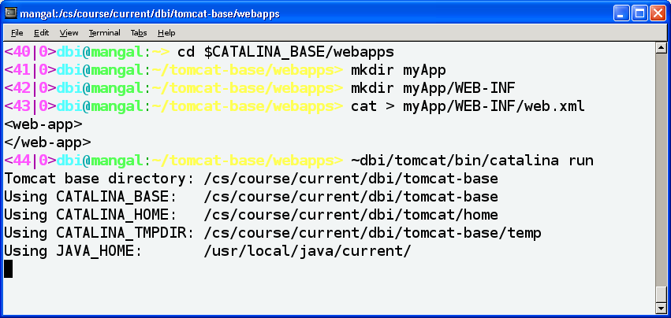
From Scratch to Applications

Slide 102
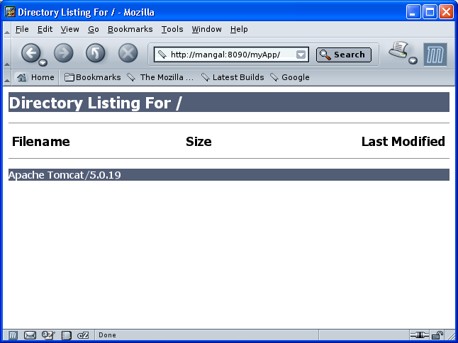

Slide 103
Configuring a Web Application
Application-specific configuration and declarations are written in the file myApp/WEB-INF/web.xml
This file contains:
Servlet declarations, mappings and parameters
Default files for directory requests
Error pages (sent in cases of HTTP errors)
Security constraints
Session time-out specification
Context (application) parameters
And more…

Slide 104
Error Pages
Use the error-page element to define the page sent in case of an HTTP error that occurs within the application context
An error page element has two sub elements:
error-code - the HTTP error status code
location - the page that should be sent

Slide 105
Welcome Page Example
<html>
<head><title>Not Found</title></head>
<body>
<h1 style="text-align:center; color:green">
Sorry, no such file...
</h1>
</body>
</html>
my404.html
<web-app>
<error-page>
<error-code>404</error-code>
<location>/my404.html</location>
</error-page>
</web-app>
web.xml

Slide 106
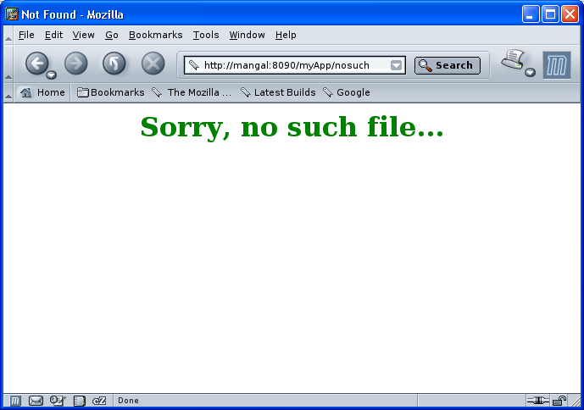

Slide 107
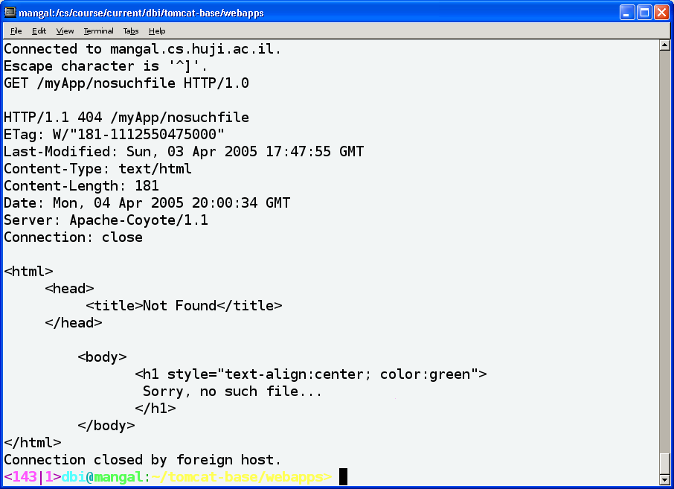

Slide 108
Welcome Pages
The (optional) welcome-file-list element contains a list of file names
When the URL request is a directory name, Tomcat automatically brings the first file on the list
If that file is not found, the server then tries the next file in the list, and so on
This file can be of any type, e.g., HTML, JSP, image, etc.
The default welcome list for all applications is set in $CATALINA_BASE/conf/web.xml

Slide 109
Welcome Page Example
<html>
<head><title>Welcome</title></head>
<body>
<h1 style="text-align:center; color:red">
Welcome Dear Visitor!
</h1>
</body>
</html>
welcome.html
<web-app>
<welcome-file-list>
<welcome-file>welcome.html</welcome-file>
<welcome-file>index.html</welcome-file>
<welcome-file>index.jsp</welcome-file>
</welcome-file-list>
</web-app>
web.xml

Slide 110
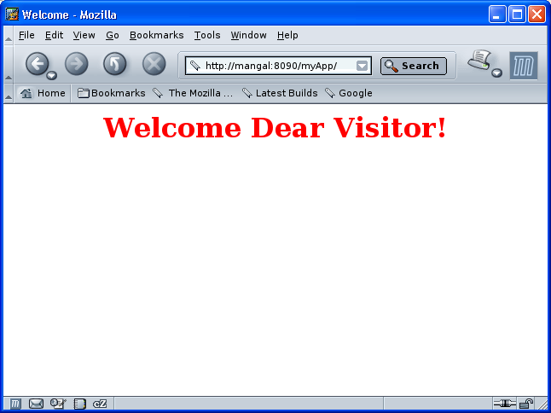

Slide 111
What is JDBC?
“An API that lets you access virtually any tabular data source from the Java programming language”
JDBC Data Access API – JDBC Technology Homepage
What’s an API?
See J2SE documentation
What’s a tabular data source?
“… access virtually any data source, from relational databases to spreadsheets and flat files.”
JDBC Documentation
We’ll focus on accessing Oracle databases

Slide 112
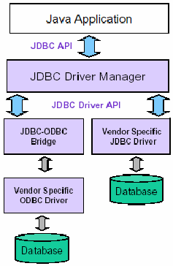
General Architecture
What design pattern is implied in this architecture?
What does it buy for us?
Why is this architecture also multi-tiered?

Slide 113
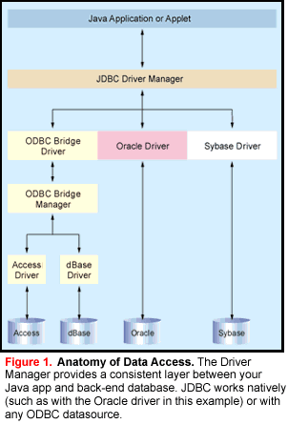

Slide 114
Basic steps to use a database in Java
1.Establish a connection
2.Create JDBC Statements
3.Execute SQL Statements
4.GET ResultSet
5.Close connections

Slide 115
1. Establish a connection
import java.sql.*;
Load the vendor specific driver
Class.forName("oracle.jdbc.driver.OracleDriver");
What do you think this statement does, and how?
Dynamically loads a driver class, for Oracle database
Make the connection
Connection con = DriverManager.getConnection( "jdbc:oracle:thin:@oracle-prod:1521:OPROD", username, passwd);
What do you think this statement does?
Establishes connection to database by obtaining a Connection object

Slide 116
2. Create JDBC statement(s)
Statement stmt = con.createStatement() ;
Creates a Statement object for sending SQL statements to the database

Slide 117
Executing SQL Statements
String createLehigh = "Create table Lehigh " +
"(SSN Integer not null, Name VARCHAR(32), " + "Marks Integer)";
stmt.executeUpdate(createLehigh);
//What does this statement do?
String insertLehigh = "Insert into Lehigh values“ + "(123456789,abc,100)";
stmt.executeUpdate(insertLehigh);

Slide 118
Get ResultSet
String queryLehigh = "select * from Lehigh";
ResultSet rs = Stmt.executeQuery(queryLehigh);
//What does this statement do?
while (rs.next()) {
int ssn = rs.getInt("SSN");
String name = rs.getString("NAME");
int marks = rs.getInt("MARKS");
}

Slide 119
Close connection
stmt.close();
con.close();

Slide 120
Transactions and JDBC
JDBC allows SQL statements to be grouped together into a single transaction
Transaction control is performed by the Connection object, default mode is auto-commit, I.e., each sql statement is treated as a transaction
We can turn off the auto-commit mode with con.setAutoCommit(false);
And turn it back on with con.setAutoCommit(true);
Once auto-commit is off, no SQL statement will be committed until an explicit is invoked con.commit();
At this point all changes done by the SQL statements will be made permanent in the database.

Slide 121
Handling Errors with Exceptions
Programs should recover and leave the database in a consistent state.
If a statement in the try block throws an exception or warning, it can be caught in one of the corresponding catch statements
How might a finally {…} block be helpful here?
E.g., you could rollback your transaction in a catch { …} block or close database connection and free database related resources in finally {…} block

Slide 122
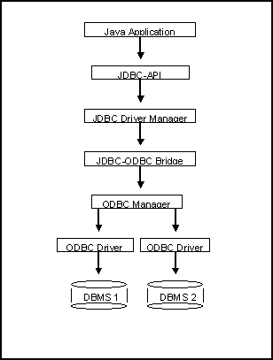
Another way to access database (JDBC-ODBC)
What’s a bit different
about this architecture?
Why add yet
another layer?

Slide 123
Sample program
import java.sql.*;
class Test {
public static void main(String[] args) {
try {
Class.forName("sun.jdbc.odbc.JdbcOdbcDriver"); //dynamic loading of driver
String filename = "c:/db1.mdb"; //Location of an Access database
String database = "jdbc:odbc:Driver={Microsoft Access Driver (*.mdb)};DBQ=";
database+= filename.trim() + ";DriverID=22;READONLY=true}"; //add on to end
Connection con = DriverManager.getConnection( database ,"","");
Statement s = con.createStatement();
s.execute("create table TEST12345 ( firstcolumn integer )");
s.execute("insert into TEST12345 values(1)");
s.execute("select firstcolumn from TEST12345");

Slide 124
Sample program(cont)
ResultSet rs = s.getResultSet();
if (rs != null) // if rs == null, then there is no ResultSet to view
while ( rs.next() ) // this will step through our data row-by-row
{ /* the next line will get the first column in our current row's ResultSet
as a String ( getString( columnNumber) ) and output it to the screen */
System.out.println("Data from column_name: " + rs.getString(1) );
}
s.close(); // close Statement to let the database know we're done with it
con.close(); //close connection
}
catch (Exception err) { System.out.println("ERROR: " + err); }
}
}

Slide 125
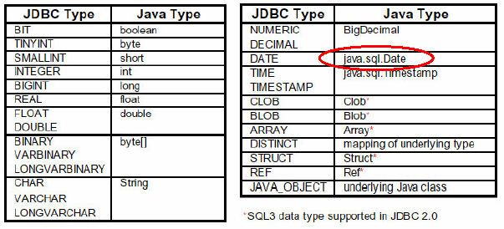
Mapping types JDBC - Java

Slide 126
JDBC 2 – Scrollable Result Set
…
Statement stmt =
con.createStatement(ResultSet.TYPE_SCROLL_INSENSITIVE,
ResultSet.CONCUR_READ_ONLY);
String query = “select students from class where type=‘not sleeping’ “;
ResultSet rs = stmt.executeQuery( query );
rs.previous(); / / go back in the RS (not possible in JDBC 1…)
rs.relative(-5); / / go 5 records back
rs.relative(7); / / go 7 records forward
rs.absolute(100); / / go to 100th record
…

Slide 127
JDBC 2 – Updateable ResultSet
…
Statement stmt =
con.createStatement(ResultSet.TYPE_FORWARD_ONLY,
ResultSet.CONCUR_UPDATABLE);
String query = " select students, grade from class
where type=‘really listening this presentation☺’ “;
ResultSet rs = stmt.executeQuery( query );
…
while ( rs.next() )
{
int grade = rs.getInt(“grade”);
rs.updateInt(“grade”, grade+10);
rs.updateRow();
}

Slide 128
Metadata from DB
A Connection's database is able to provide schema information describing its tables, its supported SQL grammar, its stored procedures the capabilities of this connection, and so on
What is a stored procedure?
Group of SQL statements that form a logical unit and perform a particular task
This information is made available through a DatabaseMetaData object.

Slide 129
Metadata from DB - example
…
Connection con = …. ;
DatabaseMetaData dbmd = con.getMetaData();
String catalog = null;
String schema = null;
String table = “sys%”;
String[ ] types = null;
ResultSet rs =
dbmd.getTables(catalog , schema , table , types );
…

Slide 130
Understanding JSP
JavaServer Pages (JSP) is a complimentary technology to Java Servlet which facilitates the mixing of dynamic and static web contents.
JSP is Java's answer to the popular Microsoft's Active Server Pages (ASP).
JSP, like ASP, provides a elegant way to mix static and dynamic contents.
The main page is written in regular HTML, while special tags are provided to insert pieces of Java programming codes.
The business programming logic and the presentation are cleanly separated.
This allows the programmers to focus on the business logic, while the web designer to concentrate on the presentation.
JSP is based on Servlet.
In fact, we shall see later that a JSP page is internally translated into a Java servlet.

Slide 131
Understanding JSP
JSP makes the creation and maintenance of dynamic HTML pages much easier than servlet.
JSP is more convenience than servlet for dealing with the presentation, not more powerful.
JSP is meant to compliment Servlet, not a replacement.
In a Model-View-Control (MVC) design, servlets are used for the controller, which involves complex programming logic.
JSPs are used for the view, which deals with presentation.
The model could be implemented using JavaBeans or Enterprise JavaBeans (EJB) which may interface with a database

Slide 132
What is JSTL?
JSTL (JSP Standard Tag Libraries) is a collection of JSP custom tags developed by Java Community Process, www.jcp.org. The reference implementation is developed by the Jakarta project, jakarta.apache.org.
Full JSTL
– Contains many common and useful JSP custom tags
– Particularly useful when you are using MVC, but the data contains a varying number of entries
– Based on the Struts looping and logic tags
– Not part of the JSP 1.2, 2.0, or 2.1 specs.
It is a separate specification that requires a separate download.
The JSP Standard Tag Library (JSTL) is a very new component released by Sun for JSP programming.
JSTL allows you to program your JSP pages using tags, rather than the scriptlet code that most JSP programmers are already accustomed to. JSTL can do nearly everything that regular JSP scriptlet code can do.

Slide 133
Installing JSTL
To use JSTL, you must have a JSP 1.2 (or higher) container installed. One of the most commonly used JSP containers is the Apache Tomcat Web server. You can obtain a copy of Tomcat from http://jakarta.apache.org/tomcat/. Using Tomcat alone will allow you to use regular JSP scriptlet code. To use JSTL, you must install JSTL into Tomcat. JSTL can be obtained from the same source as Tomcat.
The main URL for JSTL is http://java.sun.com/products/jsp/jstl/. You get jstl-api-1.2.jar and jstl-impl-1.2.jar from this site. To use JSTL, you must unzip the distribution files and install them into the correct locations within Tomcat.
For Older Versions, we will also need jstl.jar and standard.jar which you can download from http://archive.apache.org/dist/jakarta/taglibs/standard-1.0/
In fact choose the binaries :
http://archive.apache.org/dist/jakarta/taglibs/standard-1.0/binaries/
Note : For more details on versions and taglibs, refer to the preface page at the end of this sesssion.

Slide 134
Installing JSTL
To properly install JSTL for use with Tomcat, follow these three steps:
Copy the JSTL JAR files to Tomcat's lib directory. If you are using Windows, the likely location of your lib directory is C:\Apache Tomcat 6.0\webapps\ROOT\WEB-INF\lib. There are a number of JAR files included with the JSTL release. You should copy each of these JAR files to the Tomcat JAR directory.
In Tomcat 6.0, copy it to C:\Apache Tomcat 6.0\lib and if you are using older version say Tomcat5.5, copy it to C:\Apache Tomcat 5.5\common\lib
Copy the JSTL TLD files to Tomcat's web-inf directory. The web-inf directory is likely at this location: C:\Apache Tomcat 6.0\webapps\ROOT\WEB-INF. If you examine the JSTL distribution files, you should notice eight files that end with the TLD extension. All eight files should be copied to your web-inf directory.

Slide 135
Installing JSTL
Modify the web.xml file to include the TLD files. Finally, you must modify your web.xml, and add an entry for all eight of the tag libraries that you added. This consists of adding <taglib> directives inside the main <web-app> directive. The entries you should add are listed here. <taglib> <taglib-uri>http://java.sun.com/jstl/fmt</taglib-uri> <taglib-location>/WEB-INF/fmt.tld</taglib-location> </taglib> <taglib> <taglib-uri>http://java.sun.com/jstl/fmt-rt</taglib-uri> <taglib-location>/WEB-INF/fmt-rt.tld</taglib-location> </taglib>
<taglib> <taglib-uri>http://java.sun.com/jstl/core</taglib-uri> <taglib-location>/WEB-INF/c.tld</taglib-location> </taglib>

Slide 136
Installing JSTL
<taglib> <taglib-uri>http://java.sun.com/jstl/core-rt</taglib-uri> <taglib-location>/WEB-INF/c-rt.tld</taglib-location> </taglib> <taglib> <taglib-uri>http://java.sun.com/jstl/sql</taglib-uri> <taglib-location>/WEB-INF/sql.tld</taglib-location> </taglib> <taglib> <taglib-uri>http://java.sun.com/jstl/sql-rt</taglib-uri> <taglib-location>/WEB-INF/sql-rt.tld</taglib-location> </taglib> <taglib> <taglib-uri>http://java.sun.com/jstl/x</taglib-uri> <taglib-location>/WEB-INF/x.tld</taglib-location> </taglib> <taglib> <taglib-uri>http://java.sun.com/jstl/x-rt</taglib-uri> <taglib-location>/WEB-INF/x-rt.tld</taglib-location> </taglib>

Slide 137
Installing JSTL
After completing the preceding three steps, you are now ready to test your installation of JSTL. This can be done by creating a JSP page that uses JSTL. A very simple example would be the "count to ten" example. You should place your JSP file inside the Webroot directory (C:\Apache Tomcat 6.0\webapps\ ROOT). Once the Tomcat server is started, you should be able to browse to http://localhost:8080/count.jsp to see your page.
If you do not have JSTL installed correctly, there will likely be no error message. If JSTL is not interpreting your tags, they will be passed through directly to the Web browser. The Web browser will interpret these tags as unknown HTML tags. Most browsers simply ignore the unknown HTML tags.

Slide 138
count to ten Example Using scriptlet:
JSTL was introduced to allow JSP programmers to program using tags rather than Java code.
To show why this is preferable, a quick example is in order. We will examine a very simple JSP page that counts to ten.
We will examine this page both as regular scriptlet-based JSP, and then as JSTL. When the count to ten example is programmed using scriptlet based JSP, the JSP page appears as follows.`
<html> <head> <title>Count to 10 in JSP scriptlet</title> </head> <body> <% for(int i=1;i<=10;i++) {%> <%=i%><br/> <% } %> </body> </html>

Slide 139
As you can see from the preceding example, using scriptlet code produces page source code that contains a mix of HTML tags and Java statements. There are several reasons why this mixing of programming styles is not optimal.
The primary reason that it is not optimal to mix scriptlet and tag-based code is readability. This readability applies both to humans and computers. JSTL allows the human programmer to look at a program that consists entirely of HTML and HTML-like tags.
The readability of JSP scriptlet code does not just apply to human beings. The mixing of scriptlet and HTML code is also hard for computers to read. This is particularly true of HTML authoring tools such as Someone's Dreamweaver and Microsoft FrontPage. Currently, most HTML authoring tools will segregate JSP scriptlet code as non-editable blocks. The HTML authoring tools usually do not modify the JSP scriptlet code directly.

Slide 140
count to ten Example Using JSTL:
The following code shows how the count to ten example would be written using JSTL. As you can see, this code listing is much more constant, as only tags are used. HTML and JSTL tags are mixed to produce the example.
<%@ taglib uri="http://java.sun.com/jstl/core" prefix="c" %> <html> <head> <title>Count to 10 Example (using JSTL)</title> </head> <body> <c:forEach var="i" begin="1" end="10" step="1"> <c:out value="${i}" /> <br /> </c:forEach> </body> </html>

Slide 141
When you examine the preceding source code, you can see that the JSP page consists entirely of tags.
The above code makes use of HTML tags such as <head> and <br>. The use of tags is not confined just to HTML tags. We can modify that code to print numbers from 1 to n. The code is given in the next slide.
This code also makes use of JSTL tags such as <c:forEach> and <c:out>. In this article you will be introduced to some of the basics of JSTL.

Slide 142
Print 1 to n Example Using JSTL:
The following code shows how the count to n example would be written using JSTL. As you can see, this code listing is much more constant, as only tags are used. HTML and JSTL tags are mixed to produce the example. You can just use http://localhost:8080/count1.jsp?number=10 to see the result.
<%@ taglib prefix="c" uri="http://java.sun.com/jstl/core" %> <HTML> <HEAD> </HEAD> <BODY> <c:set var="n" value="${param.number}" /> Hello ...Printing numbers till N= <c:out value="${n}"/> <br/> <br/> <c:forEach var="i" begin="1" end="${n}" step="1"> <c:out value="${i}"/> </c:forEach> </BODY>

Slide 143
The JSTL Tag Libraries
The JavaServer Pages Standard Tag Library (JSTL) is a collection of useful JSP tags which encapsulates core functionality common to many JSP applications. JSTL is often spoken of as a single-tag library.
JSTL has support for common, structural tasks such as iteration and conditionals, tags for manipulating XML documents, internationalization tags, and SQL tags. It also provides a framework for integrating existing custom tags with JSTL tags.
The JSTL tags can be classified, according to their functions, into following JSTL tag library groups that can be used when creating a JSP page:

Slide 144
The JSTL Tag Libraries
The JSTL tags can be classified, according to their functions,
into following JSTL tag library groups that can be used when
creating a JSP page:
Core Tags
Formatting tags
SQL tags
XML tags
JSTL Functions

Slide 145
The JSTL Tag Libraries
Core Tag Library—Contains tags that are essential to nearly any Web application. Examples of core tag libraries include looping, expression evaluation, and basic input and output.
Formatting/Internationalization Tag Library—Contains tags that are used to parse data. Some of these tags will parse data, such as dates, differently based on the current locale.
Database Tag Library—Contains tags that can be used to access SQL databases. These tags are normally used only to create prototype programs. This is because most programs will not handle database access directly from JSP pages. Database access should be embedded in EJBs that are accessed by the JSP pages.
XML Tag Library—Contains tags that can be used to access XML elements. Because XML is used in many Web applications, XML processing is an important feature of JSTL.
JSTL Functions --JSTL includes a number of standard functions, most of which are common string manipulation functions.

Slide 146
Core Tags:
The core group of tags are the most frequently used JSTL tags. Following is
the syntax to include JSTL Core library in your JSP:
<%@ taglib prefix="c" uri="http://java.sun.com/jsp/jstl/core" %>
There are following Core JSTL Tags:
Tag | Description
<c:out > | Like <%= ... >, but for expressions.
<c:set > | Sets the result of an expression evaluation in a 'scope'
<c:remove > | Removes a scoped variable (from a particular scope, if specified).
<c:catch> | Catches any Throwable that occurs in its body and optionally exposes it.
<c:if> | Simple conditional tag which evalutes its body if the supplied condition is true.
<c:choose> | Simple conditional tag that establishes a context for mutually exclusive conditional operations, marked by <when> and <otherwise>
<c:when> | Subtag of <choose> that includes its body if its condition evalutes to 'true'.
<c:otherwise > | Subtag of <choose> that follows <when> tags and runs only if all of the prior conditions evaluated to 'false'.
<c:import> | Retrieves an absolute or relative URL and exposes its contents to either the page, a String in 'var', or a Reader in 'varReader'.
<c:forEach > | The basic iteration tag, accepting many different collection types and supporting subsetting and other functionality .
<c:forTokens> | Iterates over tokens, separated by the supplied delimeters.
<c:param> | Adds a parameter to a containing 'import' tag's URL.
<c:redirect > | Redirects to a new URL.
<c:url> | Creates a URL with optional query parameters

Slide 147
Formatting tags:
The JSTL formatting tags are used to format and display text, the date, the
time, and numbers for internationalized Web sites. Following is the syntax to
include Formatting library in your JSP:
<%@ taglib prefix="fmt" uri="http://java.sun.com/jsp/jstl/fmt" %>
Following is the list of Formatting JSTL Tags:
Tag | Description
<fmt:formatNumber> | To render numerical value with specific precision or format.
<fmt:parseNumber> | Parses the string representation of a number, currency, or percentage.
<fmt:formatDate> | Formats a date and/or time using the supplied styles and pattern
<fmt:parseDate> | Parses the string representation of a date and/or time
<fmt:bundle> | Loads a resource bundle to be used by its tag body.
<fmt:setLocale> | Stores the given locale in the locale configuration variable.
<fmt:setBundle> | Loads a resource bundle and stores it in the named scoped variable or the bundle configuration variable.
<fmt:timeZone> | Specifies the time zone for any time formatting or parsing actions nested in its body.
<fmt:setTimeZone> | Stores the given time zone in the time zone configuration variable
<fmt:message> | To display an internationalized message.
<fmt:requestEncoding> | Sets the request character encoding

Slide 148
SQL tags:
The JSTL SQL tag library provides tags for interacting with relational databases (RDBMSs) such as Oracle, mySQL, or Microsoft SQL Server.
Following is the syntax to include JSTL SQL library in your JSP:
<%@ taglib prefix="sql" uri="http://java.sun.com/jsp/jstl/sql" %>
Following is the list of SQL JSTL Tags:
Tag | Description
<sql:setDataSource> | Creates a simple DataSource suitable only for prototyping
<sql:query> | Executes the SQL query defined in its body or through the sql attribute.
<sql:update> | Executes the SQL update defined in its body or through the sql attribute.
<sql:param> | Sets a parameter in an SQL statement to the specified value.
<sql:dateParam> | Sets a parameter in an SQL statement to the specified java.util.Date value.
<sql:transaction > | Provides nested database action elements with a shared Connection, set up to execute all statements as one transaction.

Slide 149
XML tags:
The JSTL XML tags provide a JSP-centric way of creating and manipulating XML documents. Following is the syntax to include JSTL XML library in your JSP:
<%@ taglib prefix="x" uri="http://java.sun.com/jsp/jstl/xml" %>
The JSTL XML tag library has custom tags for interacting with XML data. This includes parsing XML, transforming XML data, and flow control based on XPath expressions.
Before you proceed with the examples, you would need to copy following two XML and XPath related libraries into your <Tomcat Installation Directory>\lib:
XercesImpl.jar: Download it from http://www.apache.org/dist/xerces/j/
xalan.jar: Download it from http://xml.apache.org/xalan-j/index.html

Slide 150
Following is the list of XML JSTL Tags:
Tag | Description
<x:out> | Like <%= ... >, but for XPath expressions.
<x:parse> | Use to parse XML data specified either via an attribute or in the tag body.
<x:set > | Sets a variable to the value of an XPath expression.
<x:if > | Evaluates a test XPath expression and if it is true, it processes its body. If the test condition is false, the body is ignored.
<x:forEach> | To loop over nodes in an XML document.
<x:choose> | Simple conditional tag that establishes a context for mutually exclusive conditional operations, marked by <when> and <otherwise>
<x:when > | Subtag of <choose> that includes its body if its expression evalutes to 'true'
<x:otherwise > | Subtag of <choose> that follows <when> tags and runs only if all of the prior conditions evaluated to 'false'
<x:transform > | Applies an XSL transformation on a XML document
<x:param > | Use along with the transform tag to set a parameter in the XSLT stylesheet

Slide 151
JSTL Functions:
JSTL includes a number of standard functions, most of which are common
string manipulation functions. Following is the syntax to include JSTL
Functions library in your JSP:
<%@ taglib prefix="fn" uri="http://java.sun.com/jsp/jstl/functions" %>
Following is the list of JSTL Functions:
Function | Description
fn:contains() | Tests if an input string contains the specified substring.
fn:containsIgnoreCase() | Tests if an input string contains the specified substring in a case insensitive way.
fn:endsWith() | Tests if an input string ends with the specified suffix.
fn:escapeXml() | Escapes characters that could be interpreted as XML markup.
fn:indexOf() | Returns the index within a string of the first occurrence of a specified substring.
fn:join() | Joins all elements of an array into a string.
fn:length() | Returns the number of items in a collection, or the number of characters in a string.
fn:replace() | Returns a string resulting from replacing in an input string all occurrences with a given string.
fn:split() | Splits a string into an array of substrings.

Slide 152
In this session, we will only take a brief look at a few of the core tags. We will examine a simple example that shows how to process data that a user enters into a form. Before we examine this program, we must first see how JSTL handles expressions. Expression handling in JSTL is accomplished by using the EL expression language, just as it is done in JSP 2.0. In the subsequent sessions, we will examine the EL expression language.

Slide 153
The EL Expression Language
One major component of JSP 2.0 is the new expression language named EL. EL is used extensively in JSTL. However, it is important to remember that EL is a feature of JSP and not of JSTL. JSP scriptlet code used with JSP 2.0 can contain EL expressions. The following lines of code demonstrate using EL inside of JSP scriptlet code:
<p> Your total, including shipping is ${total+shipping} </p>
As you can see from the preceding code, the values "total" and "shipping" are added and displayed as the HTML is generated. These expressions can be used inside of JSTL tags as well. One important requirement of JSTL 1.0 was that JSTL could be used with JSP 1.2. Because JSP 1.2 does not support EL, it is necessary to provide a few additional JSTL tags that facilitate the use of EL. For example, if you wanted to use JSTL to display the above expression, you would use the following code.
<p> Your total, including shipping is <c:out var="${total+shipping"/> </p>
One of the requirements of JSTL was that it not require JSP 2.0 to run. By providing a tag that is capable of displaying EL expressions, this requirement is met.

Slide 154
JSTL Example
We will now examine a simple example that uses JSTL. For this example, we
will examine a common procedure that is done by many Web applications.
We will see how to POST a form and process the results from that POST. A
simple program that is capable of doing this is shown below:
<%@ taglib uri="http://java.sun.com/jstl/core" prefix="c" %> <html> <head> <title>If with Body</title> </head> <body> <c:if test="${pageContext.request.method=='POST'}"> <c:if test="${param.guess=='Java'}">You guessed it! <br /> <br /> <br /> </c:if>

Slide 155
JSTL Example…contd
<c:if test="${param.guess!='Java'}">You are wrong <br /> <br /> <br /> </c:if> </c:if> <form method="post">Guess what computer language I am thinking of? <input type="text" name="guess" /> <input type="submit" value="Try!" /> <br /> </form> </body> </html>

Slide 156
Creating HTML Forms with JavaServer Pages

Slide 157
A Simple HTML Form
Source Code for SimpleForm.html
<html>
<body>
<h1>Please tell me about yourself</h1>
<form action="SimpleFormHandler.jsp" method="get">
Name: <input type="text" name="firstName">
<input type="text" name="lastName"><br>
Sex:
<input type="radio" checked name="sex" value="male">Male
<input type="radio" name="sex" value="female">Female
<p>

Slide 158
A Simple HTML Form
What Java primitive type best describes your personality:
<select name="javaType">
<option value="boolean">boolean</option>
<option value="byte">byte</option>
<option value="char" selected>char</option>
<option value="double">double</option>
<option value="float">float</option>
<option value="int">int</option>
<option value="long">long</option>
</select>
<br>
<input type="submit">
</form>
</body>
</html>

Slide 159
Source Code for SimpleFormHandler.jsp
<html>
<body>
<%
// Grab the variables from the form.
String firstName = request.getParameter("firstName");
String lastName = request.getParameter("lastName");
String sex = request.getParameter("sex");
String javaType = request.getParameter("javaType");
%>
<%-- Print out the variables. --%>
<h1>Hello, <%=firstName%> <%=lastName%>!</h1>
I see that you are <%=sex%>. You know, you remind me of a
<%=javaType%> variable I once knew.
</body>
</html>

Slide 160
Source Code for MultiForm.html
<html>
<body>
<h1>Please enter a list of names</h1>
<form action="MultiFormHandler.jsp" method="get">
<input type="text" name="names"><br>
<input type="text" name="names"><br>
<input type="text" name="names"><br>
<input type="text" name="names"><br>
<input type="text" name="names"><br>
<input type="submit">
</form>
</body>
</html>

Slide 161
Source Code for MultiFormHandler.jsp
<html>
<body>
The names you entered are:
< pre>
<%
// Fetch the name values.
String names[] = request.getParameterValues("names");
for (int i=0; i < names.length; i++)
{
out.println(names[i]);
}
%>
</ pre>
</body>
</html>

Slide 162
Source Code for ShowParameters.jsp
<html>
<body>
You passed me the following parameters:
< pre>
<%
// Find out the names of all the parameters.
java.util.Enumeration params = request.getParameterNames();
while (params.hasMoreElements())
{
// Get the next parameter name.
String paramName = (String) params.nextElement();
// Use getParameterValues in case there are multiple values.
String paramValues[] =
request.getParameterValues(paramName);
// If there is only one value, print it out.
if (paramValues.length == 1)
{
out.println(paramName+"="+paramValues[0]);
}

Slide 163
Source Code for ShowParameters.jsp
else
{
// For multiple values, loop through them.
out.print(paramName+"=");
for (int i=0; i < paramValues.length; i++)
{
// If this isn't the first value, print a comma to separate values.
if (i > 0) out.print(',');
out.print(paramValues[i]);
}
out.println();
}
}
%>
</pre>
</body>
</html>

Slide 164
Source Code for ShowParametersServlet.java
package examples;
import javax.servlet.*;
import javax.servlet.http.*;
import java.io.*;
import java.util.*;
public class ShowParametersServlet extends HttpServlet
{
public void service(HttpServletRequest request,
HttpServletResponse response)
throws IOException
{
// Tell the Web server that the response is HTML.
response.setContentType("text/html");
PrintWriter out = response.getWriter();
out.println("<html>");
out.println("<body>");
out.println("You passed me the following parameters:");
out.println("<pre>");

Slide 165
Source Code for ShowParametersServlet.java
// Find out the names of all the parameters.
Enumeration params = request.getParameterNames();
while (params.hasMoreElements())
{
// Get the next parameter name.
String paramName = (String) params.nextElement();
// Use getParameterValues in case there are multiple values.
String paramValues[] =
request.getParameterValues(paramName);
// If there is only one value, print it out.
if (paramValues.length == 1)
{
out.println(paramName+
"="+paramValues[0]);
}
else

Slide 166
Source Code for ShowParametersServlet.java
{
// For multiple values, loop through them.
out.print(paramName+"=");
for (int i=0; i < paramValues.length; i++)
{
// If this isn't the first value, print a comma to separate values.
if (i > 0) out.print(',');
out.print(paramValues[i]);
}
out.println();
}
}
out.println("</pre>");
out.println("</body>");
out.println("</html>");
}
}

